Slide 1



Explainable AI with SHAP
Unlocking insights through SHAP

Slide 2


Unlocking the Power
of SHAP
Key Points:
Use SHAP (SHapley Additive exPlanations) for model interpretability.
Identify top drivers of predictions using global & local explanations.
Apply SHAP to the trained XGBoost model from chapter 5
Visual tools: Beeswarm, Bar, dependence plots.

Slide 3
Learning Objectives
Define interpretability, feature attribution, global vs local explanations.
Compute SHAP values for tree-based models.
Generate & interpret beeswarm, bar, and scatter plots.
Use SHAP to identify energy consumption drivers.
Recognize SHAP’s limitations in practice.

Slide 4


The Importance of Explainability
Builds stakeholder trust and mitigates regulatory risks

Slide 5
Why Explainability
Matters
Builds stakeholder trust (e.g., utility billing).
Avoids regulatory risks (e.g., GDPR’s “right to explanation”).
Supports debugging and feature leakage detection.
Example: A demand forecast fails due to real-time data unavailability. SHAP reveals hidden reliance.

Slide 6
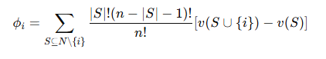


Understanding SHAP: Feature Attribution Simplified
SHAP in a Nutshell
Shapley Formula:
SHAP utilizes Shapley values for accurate feature attribution in predictions.
SHAP explains predictions by attributing contributions to each feature

Slide 7
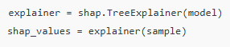

Loading Data & Computing SHAP
Implementation
1. Use XGBoost + TreeExplainer for fast computation
2. Sample 10 rows for fast computation & performance

Slide 8
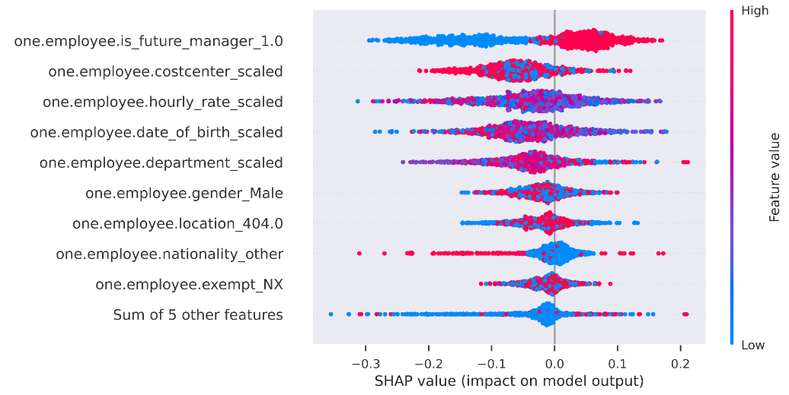
Beeswarm Plot (global feature and impact)
Understanding
SHAP
Visualizations
Beeswarm plots show feature importance and distributions of SHAP values.
Global snapshot – each dot is one row of data
Horizontal spread ⇒ impact size (right = raises prediction, left = lowers)
Colour ⇒ original feature value (red = high, blue = low).

Slide 9
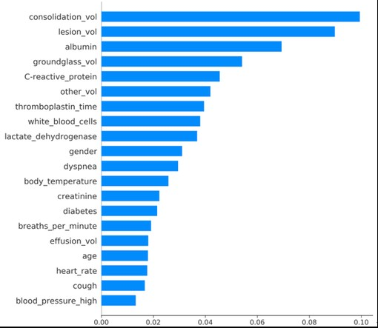
Understanding
SHAP
Visualizations
Bar Plot (ranked mean |SHAP| )
Bar plots provide clear comparisons of feature contributions to model predictions.
Mean |SHAP| ranks overall importance.
Fast “top-10 drivers” view for executives.
Good starting point before deeper dives.

Slide 10
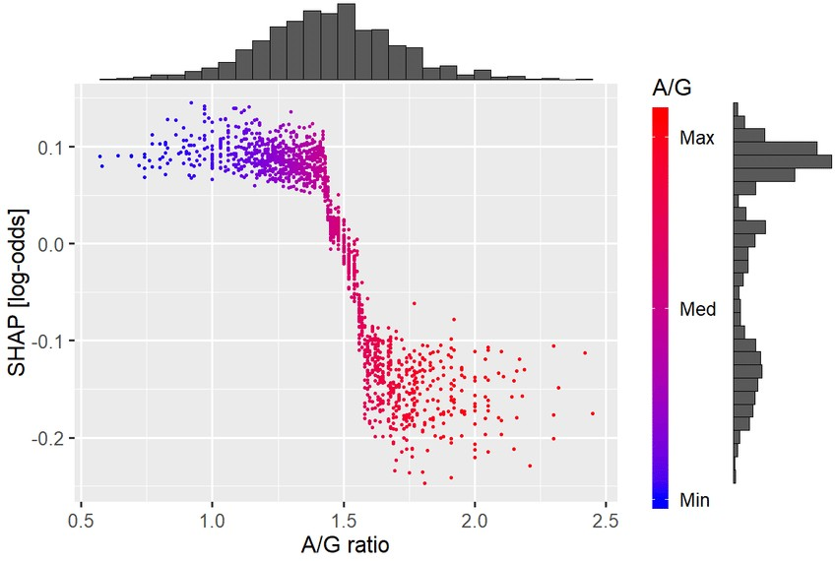
Understanding
SHAP
Visualizations
Dependence Plot (local interaction effects)
Bar plots provide clear comparisons of feature contributions to model predictions.
Zooms in on one feature.
Shows non-linear thresholds (e.g., steep change at A/G ≈ 1.4).
Colour can be set to a 2nd feature to surface interactions.

Slide 11


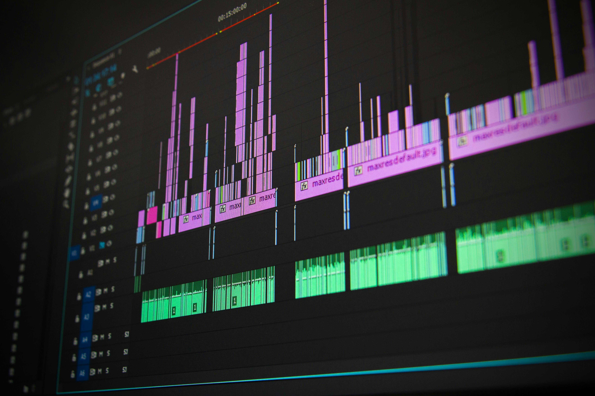
Use Case: Municipal utility introduces dynamic pricing
Insight from SHAP: hour_cos & Voltage drive peak loads at 18:00
Action: Shift tariffs → 💰 Saved $120k/year with 3% peak shaving
Real World Case Study
SHAP insights for municipal utilities yield significant cost savings.
Use Case: Municipal utility introduces dynamic pricing
Insight from SHAP: hour cost & Voltage drive peak loads at 18:00
Action: Shift tariffs → 💰 Saved $120k/year with 3% peak shaving

Slide 12



SHAP Best Practices
Concern | Mitigation
High computation cost | Use sampling or TreeSHAP
Feature correlation | Use SHAP interaction values
Model support | Use TreeSHAP for tress, KernelSHAP for others

Slide 13


Lab Tasks for SHAP Analysis
Compute SHAP values using your dataset
Generate visual plots for results
Reflect on the insights gained
Bonus interaction with peers for discussion
Compare SHAP results with traditional methods
Document your findings for future reference
Explore additional resources for deeper understanding
Share results with the class for feedback
Engage with practical tasks to understand SHAP better

Slide 14


“SHAP bridges accuracy and trust”
By translating feature importance into visual, human-understandable insights, SHAP empowers:
1. Analysts
2. Policy makers
3. Engineers

Slide 15
Thank You For Listening
The End

